Slide 1
Program 3
Mickey Ma (马毓琦): mickeyma@cuhk.edu.cn
Office: Teaching C Building Room 402(TC-402)
Phone: 0755-23519635

Slide 2

Block Diagram
opcode/
func/
ALUcontrol
operation code
Testbench
input a
reg_A
output c
reg_C
reg_B
input b
flags
flag registers

Slide 3
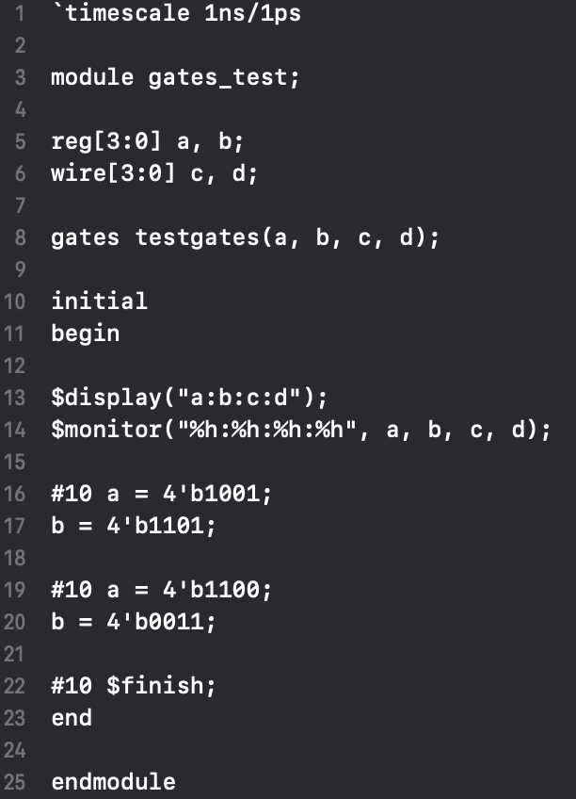

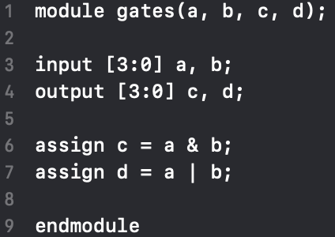
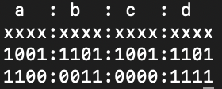
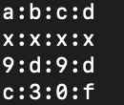
A Simple
Verilog Example
Test bench
Verilog module
Results
hexadecimal binary
https://www.doulos.com/knowhow/verilog_designers_guide/

Slide 4
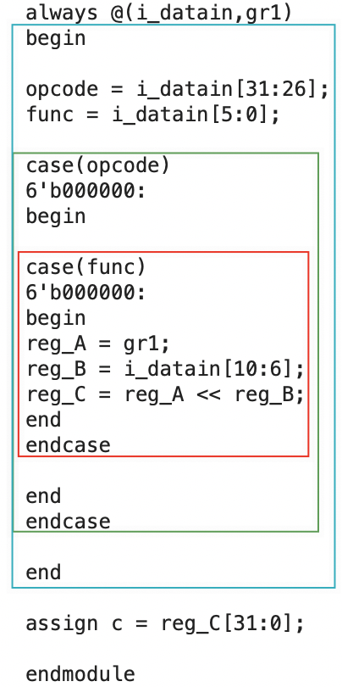
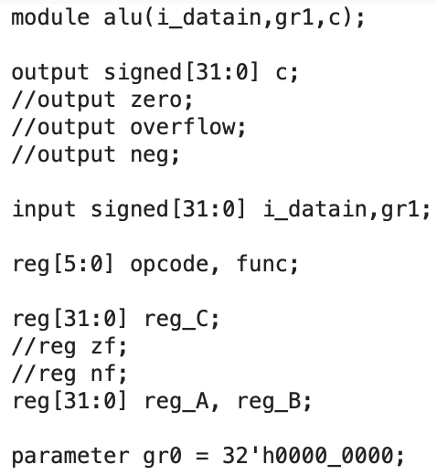
ALU.v

Slide 5
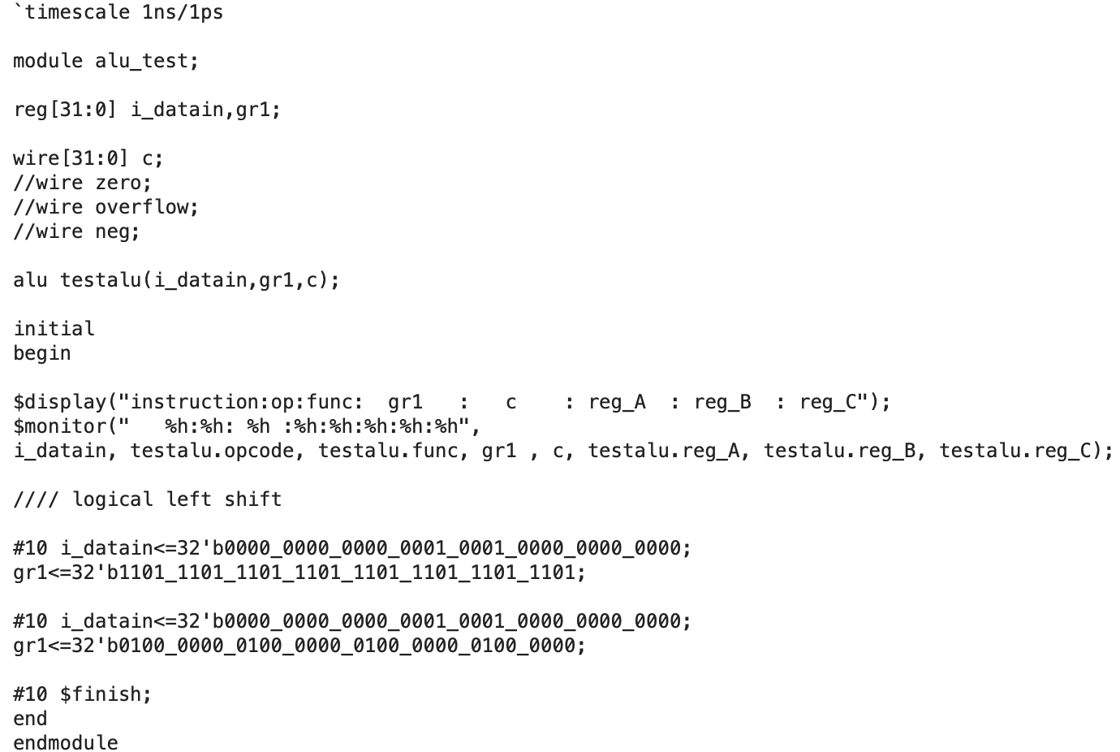
test_ALU.v

Slide 6
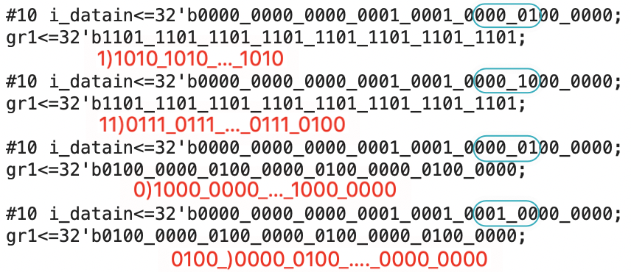
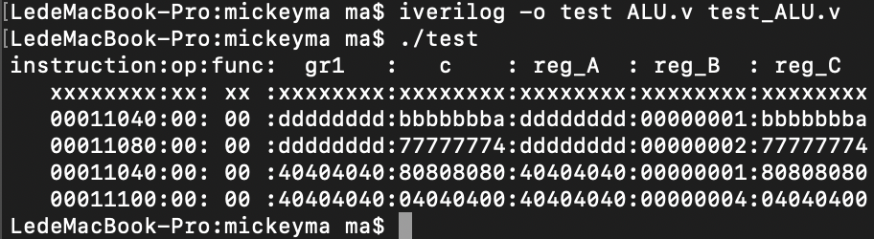
Icarus Verilog
http://iverilog.icarus.com/
Mac: https://blog.csdn.net/zach_z/article/details/78787509
Win: http://bleyer.org/icarus/

Slide 7
Grading
Support the Arithmetic/Logic operations - 60%
The ALU must support:
add, addi, addu, addiu（如果说u与非u同类则是1个否则是2个）
sub, subu（如果说u与非u同类则是1个否则是2个）
mult, multu, div, divu（如果说u与非u同类则是2个否则是4个）
and, andi, nor, or, ori, xor, xori（4个）
beq, bne, slt, slti, sltiu, sltu（如果说u与非u同类则是3个否则是4个）
lw, sw（2个如果可以和add合并的话则不考虑）
sll, sllv, srl, srlv, sra, srav（3个或者6个）
With a clear data flow from instruction to ALU - 20%
Control part
Sign/Zero extension
With special handling for flags - 10%
negative flag
Zero flag
Overflow detection Project report - 10%

Slide 8
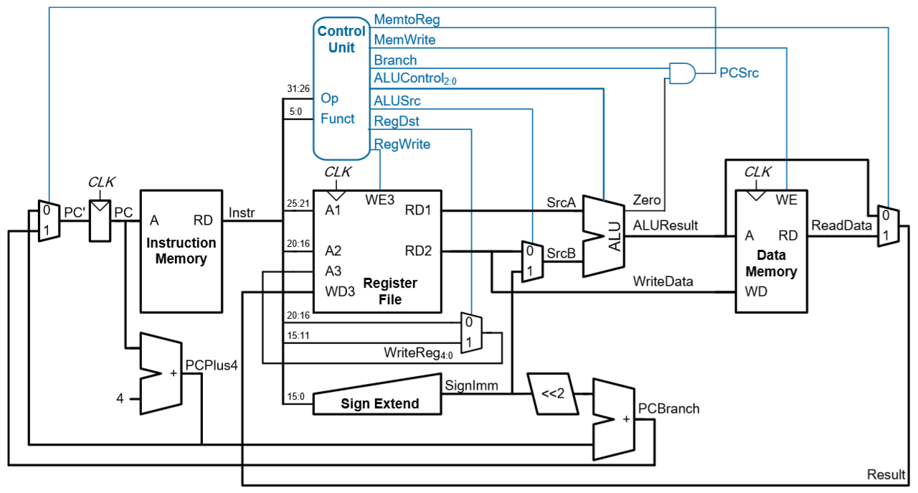
Single-cycle MIPS Processor

